Slide 1
Artificial Intelligence
Lecture 4

Slide 2
Today’s Lecture
What is an agent?
Agents & Environments
Task Environment
  Performance measure
  Environment
  Actuators
  Sensors
Types of agents
  Simple Reflex Agent
  Model based Agent
  Goal based Agent
  Utility based Agent

Slide 3
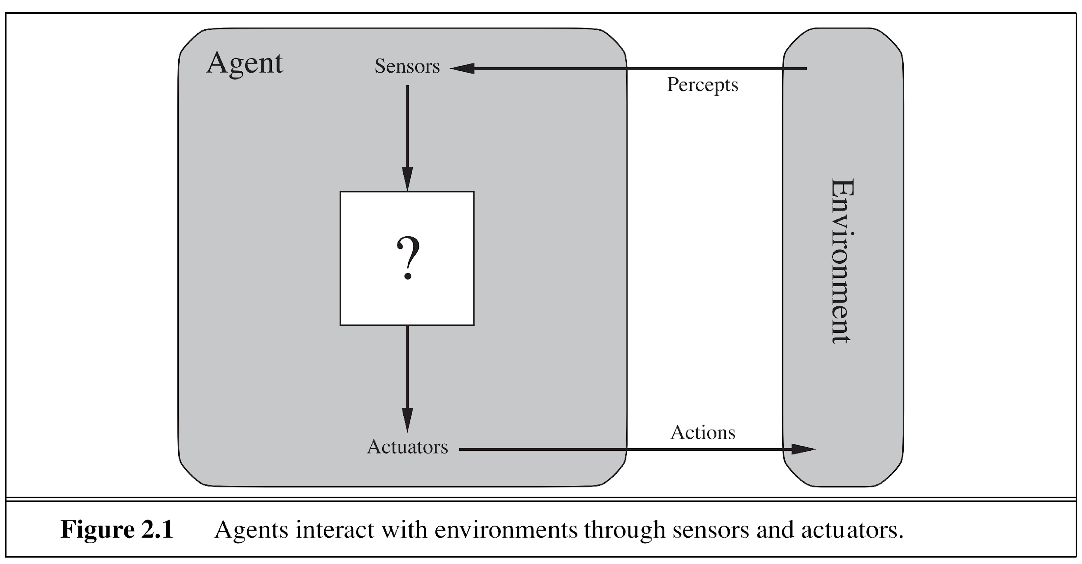
Agent Definition
An agent is anything that can be viewed as perceiving its environment through sensors and acting upon that environment using actuators. (Russell & Norvig)

Slide 4
Environments
Action done by the agent are on the environment.
Environment provides percepts to the agent.
Environment determines the interaction between the “outside world” and the agent
  the “outside world” is not necessarily the “real world” as we perceive it
    it may be a real or virtual environment the agent lives in
In many cases, environments are implemented within computers
  They may or may not have a close correspondence to the “real world”

Slide 5
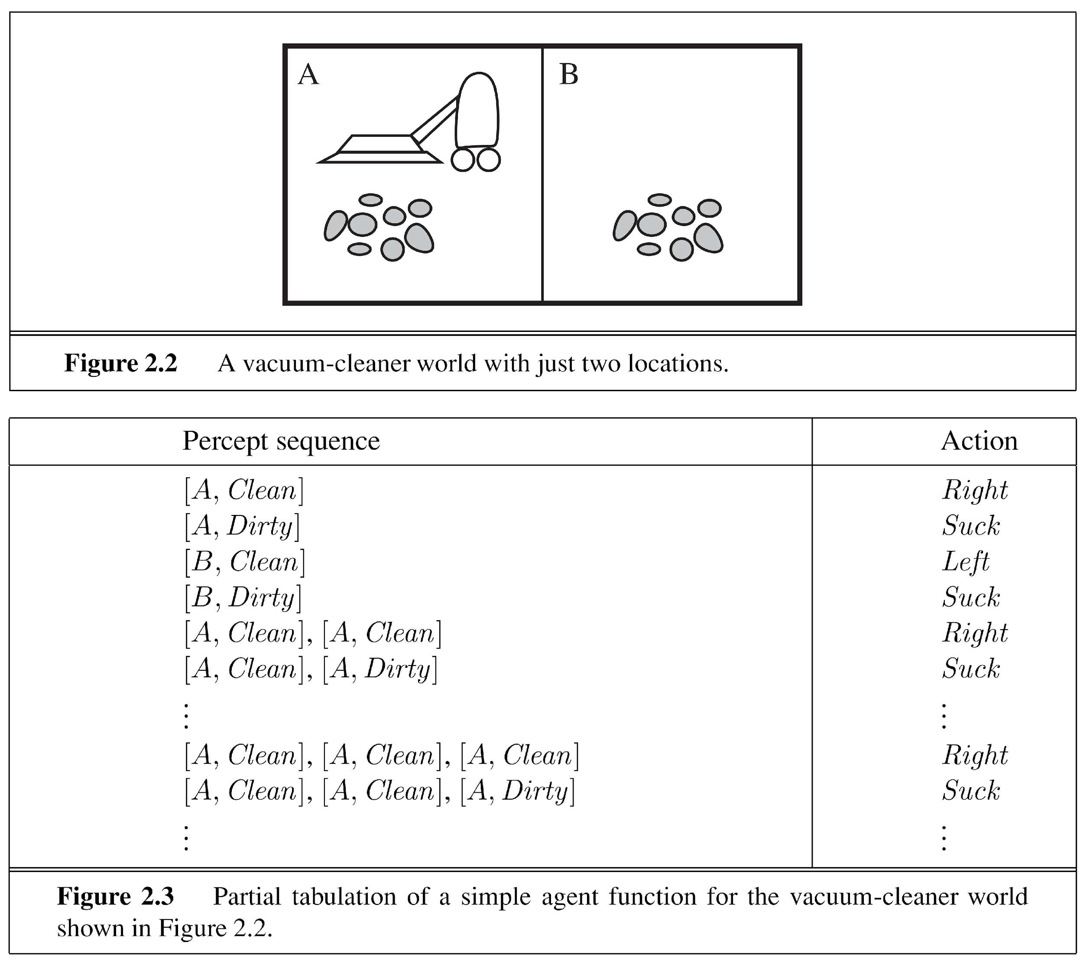

Slide 6
Agents example
Human agent:
  eyes, ears, and other organs for sensors;
  hands, legs, mouth, and other body parts for actuators
Robotic agent:
  cameras and infrared range finders for sensors
  various motors for actuators
  Software agent:
  A software agent receives keystrokes, file contents, and network packets as sensory inputs and
  acts on the environment by displaying on the screen, writing files, and sending network packets.

Slide 7
Task Environment
The task environment is a formal description or abstract representation of the environment used to design and analyze the agent’s behavior.
It focuses on the elements relevant to the task using the PEAS framework:
  Performance measure (Criteria for evaluating how successful the agent is.)
  Environment (The surroundings or world in which the agent operates.)
  Actuators (The agent’s means of acting or changing its environment.)
  Sensors (The agent’s means of perceiving or detecting information from the environment.)
Example: Taxi driver
  Performance measure: safe, fast, comfortable (maximize profits)
  Environment: roads, other traffic, pedestrians, customers
  Actuators: steering, accelerator, brake, signal, horn
  Sensors: cameras, sonar, speedometer, GPS, odometer, accelerometer, engine sensors

Slide 8
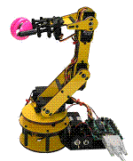
PEAS
Agent: Part-picking robot
Performance measure: Percentage of parts in correct bins
Environment: Conveyor belt with parts, bins
Actuators: Jointed arm and hand
Sensors: Camera, joint angle sensors
Agent: Medical diagnosis system
Performance measure: Healthy patient, minimize costs
Environment: Patient, hospital, staff
Actuators: Screen display (questions, tests, diagnoses, treatments, referrals)
Sensors: Keyboard (entry of symptoms, findings, patient's answers)

Slide 9
Properties of task environments
Fully observable vs. partially observable
  If an agent’s sensory equipment gives it access to the complete state of the environment at each point in time, then we say that environment is fully observable to the agent. i.e. Chess.
  An environment is effectively fully observable if the sensors detect all aspects that are relevant to the choice of action.
  A fully observable environment is convenient because the agent need not maintain any internal state to keep track of the world.
  Partially observable. i.e. Taxi driving

Slide 10
Properties of task environments
Single agent vs. Multiagents
  In the single agent environment there is only one agent
    For example, Medical diagnoses
  In multiagents systems, there are more than one active agents
    A computer software playing chess.

Slide 11
Properties of task environments
Episodic vs. sequential.
  Agent’s experience is divided into “episodes.” Each episode consists of the agent perceiving and acting.
  Subsequent episodes do not depend on what actions occur in previous episodes. i.e. Medical diagnosis
  In sequential environments current actions affect all succeeding actions. i.e. Chess, Automated Taxi Driving

Slide 12
Properties of task environments
Static vs. Dynamic
  If the environment can change while an agent is performing action, then we say the environment is dynamic. i.e Taxi driving
  Else its static.
  Static environments are easy to deal with, because the agent does not keep on looking at the environment while it is deciding on an action e.g. chess

Slide 13
Properties of task environments
Discrete vs. continuous
  If there are a limited number of distinct, clearly defined percepts and actions, we say that the environment is discrete.
    Chess, since there are a fixed number of possible moves on each turn.
    Taxi driving is continuous.

Slide 14
Properties of task environments
Deterministic vs. nondeterministic
  If the next state of the environment is completely determined by the current state and the actions selected by the agents, then we say the environment is deterministic. i.e. Chess
  If the environment is Partially observable, then it may appear to be nondeterministic (bunch of uncertainties). i.e. Taxi Driving

Slide 15
Agent types
Four basic types in order of increasing generalization:
  Simple reflex agents
  Reflex agents with state/model
  Goal-based agents
  Utility-based agents

Slide 16
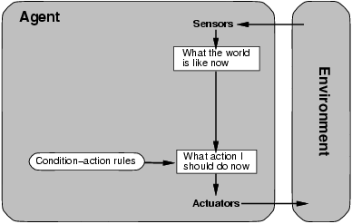
Simple reflex agents
We use rectangles to denote the current internal state of the agent’s decision process, and ovals to represent the background information used in the process.

Slide 17
Simple Reflex Agent
The simplest kind of agent is the simple reflex agent. These agents select actions on the basis of the current percept, ignoring the rest of the percept history.
Simple reflex behaviors occur even in more complex environments.
  Imagine yourself as the driver of the automated taxi. If the car in front brakes and its brake lights come on, then you should notice this and initiate braking
  Visual input is used to establish the condition we call “The car in front is braking.” Then, this triggers some established connection in the agent program to the action “initiate braking.” We call such a connection a condition–action rule, written as
    if car-in-front-is-braking then initiate-braking.

Slide 18
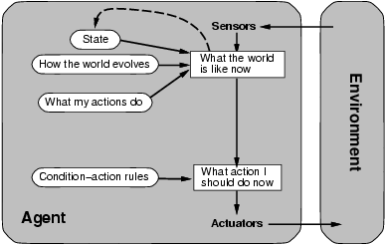
Model-based reflex agents

Slide 19
Model-based reflex agents
Simple reflex agents are simple, but they turn out to be
of limited intelligence.
A Model-Based Agent improves upon a Simple Reflex Agent by maintaining an internal state of the environment.
Further, it stores how the world evolves independently of the agent?
Second, we need some information about how the agent’s own actions affect the world.
This allows it to work in partially observable or dynamic environments where the agent cannot see everything at once.

Slide 20
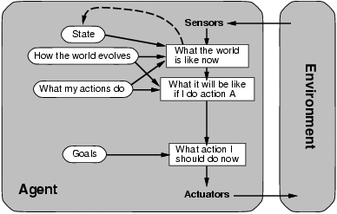
Goal-based agents

Slide 21
Goal-based agent
Merely knowing about the current state of the environment is not always enough to decide what to do next.
The right decision depends on where the taxi is trying to get to.
So the goal information is also needed.
Decision making of this kind is fundamentally different from the condition– action rules described earlier.
It involves consideration of the future—both “What will happen if I do such-and-such?” and “Would I be near to the goal?”

Slide 22
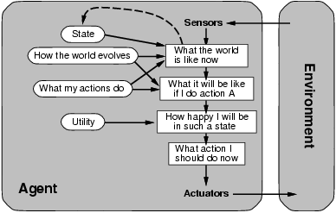
Utility-based agents

Slide 23
Utility-based agents
Goals are not really enough to generate high-quality behavior.
There are many ways to reach the destination, but some are qualitatively better than others.
  More safe
  Quicker
  Less expensive
Goals just provide a crude binary distinction between “happy” and “unhappy” states.
A more general performance measure should allow a comparison of different world states according to exactly how happy they would make the agent.

Slide 24
Today’s Lecture
What is an agent?
Agents & Environments
Task Environment
  Performance measure
  Environment
  Actuators
  Sensors
Types of agents
  Simple Reflex Agent
  Model based Agent
  Goal based Agent
  Utility based Agent

